Slide 1



Slide 2
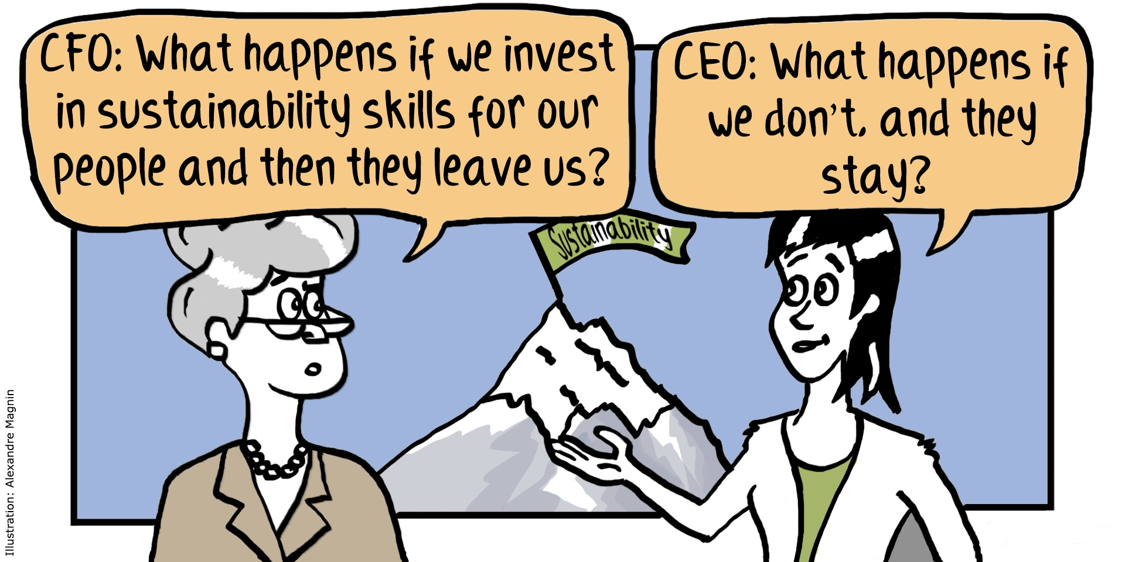

Slide 3
Office 365 will enable
you to:
Collaborate openly on teams and projects
Create and contribute to shared content
Run effective meetings
Maximize your productivity
Share your identity and expertise
Engage with community and build a knowledge base

Slide 4
Why Office 365?
Store and share
documents
Share your own documents with others through Office 365, or upload documents to a team site to build a document library and a project history
Get email, calendar,
and contacts
Use Outlook and Outlook Web App to access your email, calendar, and contacts
Work collaboratively with teams
Create a customized Office 365 site to collaborate with others
Create document libraries, add apps, and use community features to enhance sharing
Have interactive online meetings
Use Lync for online meetings that have full web conferencing features, including audio, video, sharing, and presentations

Slide 5
Our Objectives for Office 365
 | Start… | Stop…
Collaborate openly on teams and projects | Using a shared workspace Building project history | Attaching files in email Using email for discussions
Create and contribute to shared content | Storing content centrally Using collaboration tools | Storing content locally Sending revisions in email
Run effective meetings | Having online meetings Using shared workspaces | Using pay-by-minute conferencing Booking up conference rooms
Maximize my productivity | Using tasks and presence Subscribing to feeds and finding experts | Relying on old tools and practices Re-solving the same problems
Share my identity and expertise | Maintaining my profile Sharing my work | Sending updates through email Storing my work locally
Engage with community and build a knowledge base | Using social networks Proactively sharing information | Limiting my network to my physical location

